Slide 2
Defect Detection Percentage
The defect detection percentage (DDP) gives a measure of the testing effectiveness. It is calculated as a ratio of defects found found prior to release and after release by customers.

Slide 3
For example, suppose that 90 defects were found during QA/testing stage and 20 defects were found by customers after the release. The DDP would be calculated as 90 divided by (90 + 20) = 81.8%

Slide 4
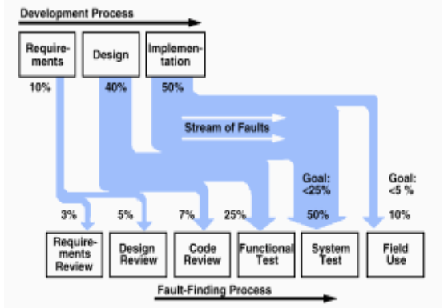

Slide 5
Find DRE for each phase and software development DRE
phase | requirement | design | Coding andunit test
requirement | 5 | - | -
design | 5 | 20 | -
coding | 0 | 5 | 30
test | 3 | 7 | 10
field | 1 | 3 | 7

Slide 6
Requirement DRE= 5/(5+5+0+3+1) *100
Design DRE =(5+20)/

